Slide 1
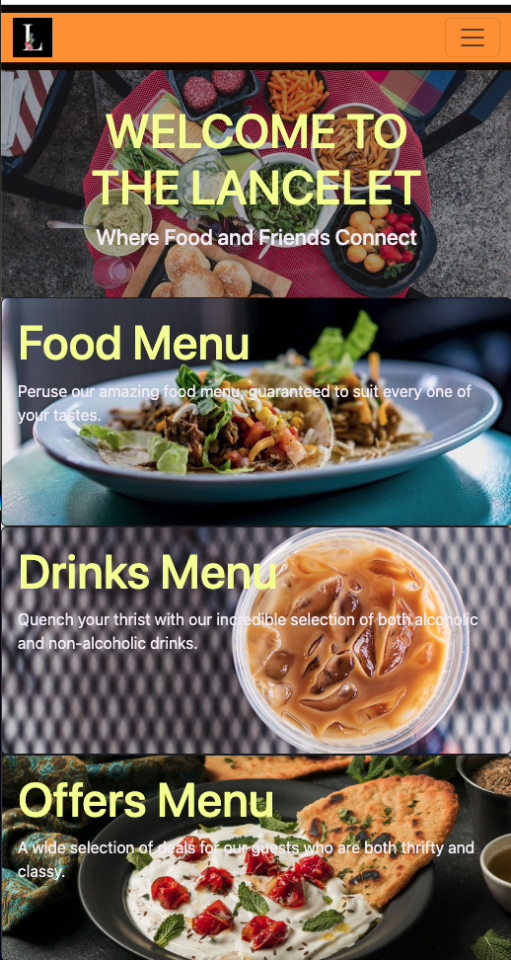
Capstone Project Review
Presented by: Chris Yates
Date: June 21, 2022

Slide 2

Problem to Solve
Competition - Restaurant Industry is a competitive landscape with oversaturation in many markets
Awareness - Knowing what food, drinks and offers a restaurant has is one of the major deciding factors consumers use to determine which restaurant they’d like to patronize
Marketing - Restaurant owners need to set themself apart and create interest before the customer enters the establishment
Brand Development - Social media can be too unreliable, competitive, and promotion systems can be haphazard and expensive
Outsourcing - over reliance on third party vendors or dedicated resources to manage website and applications
Solution: Create Restaurant Website & Mobile App to solve above pain points
June 21 2022

Slide 3
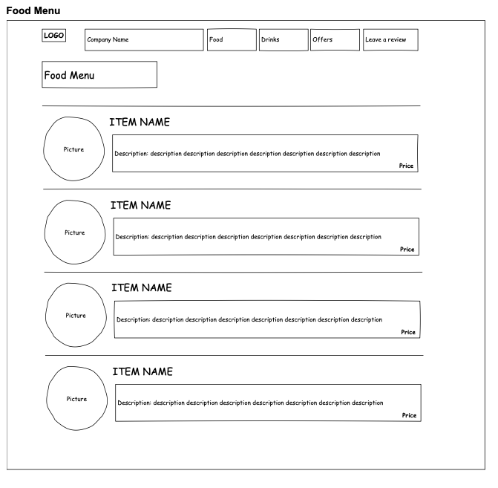
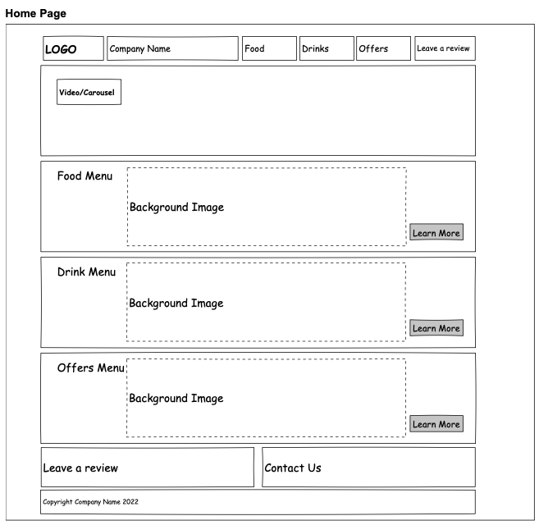
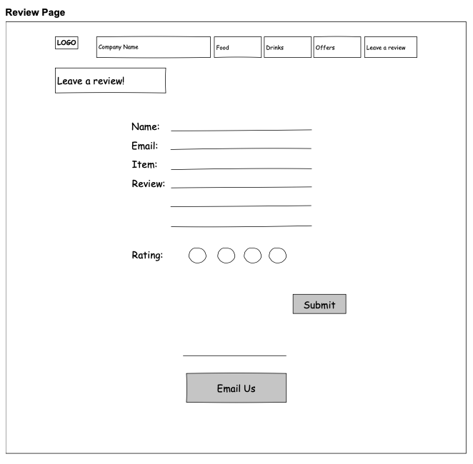
Design Mock-ups
HOME PAGE
ITEM CARDS
FORMS

Slide 4
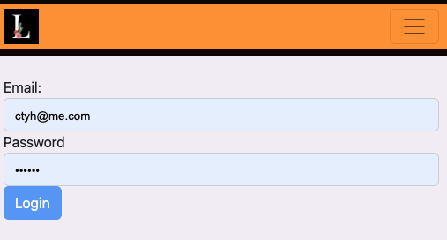
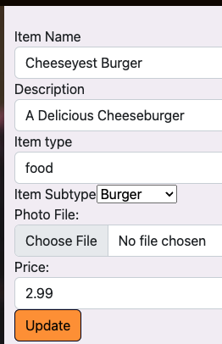
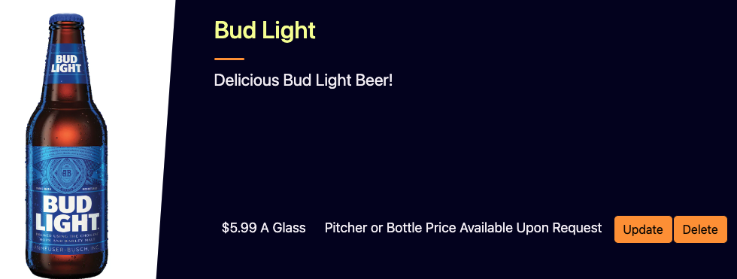
Employee Site
Employee Portal Login
Portal Navigation Bar
Update/Delete Card
Update Form

Slide 5
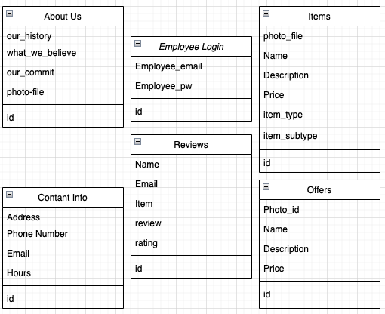

DB Diagrams
Simple DB Design
No Tables required linkage
June 21 2022

Slide 6
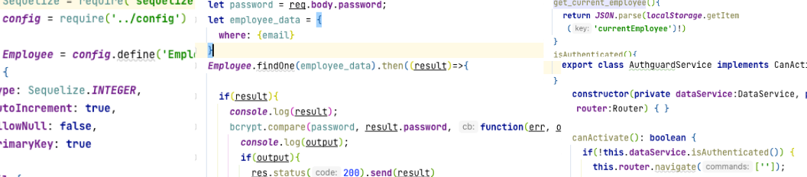
Implementation: Technology Used
BACKEND
WEB
MOBILE
Angular
Bootstrap
HTML
CSS
Javascript
Typescript
Ionic
Android
Capacitor
Cordova
Node JS
Express
Sequelize
MySQL
Heroku

Slide 7
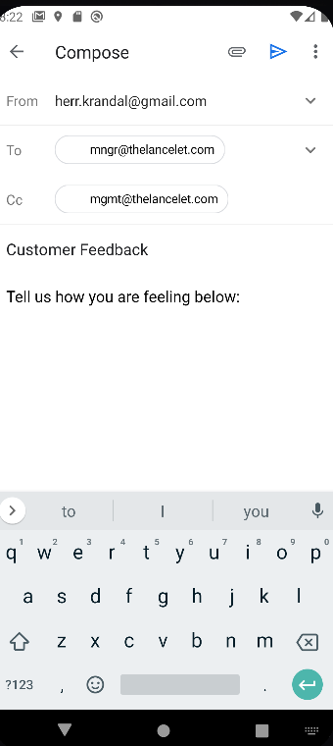
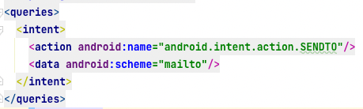

Problems Faced
Email Composer
Issue: Couldn’t get app to run in android studio
Solution: Inserted intent code into androidmanifest.xml
Lesson Learned: Thoroughly read error codes

Slide 8

Marketing
Update Social Media & Communications to include Website/App with CTA
Google Adwords/Google Search Campaign
Facebook & Instagram Ads
Twitter Ads
LinkedIn Ads

Slide 9

DEMO
June 21 2022

Slide 10
Questions?
June 21 2022

Slide 11
Appendix
June 21 2022

Slide 12
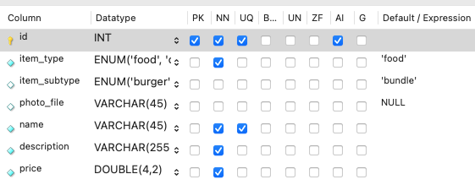
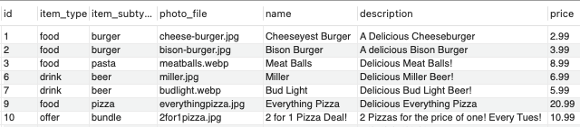
Backend (Items table example)
restaurant_db built in MySQL (Items table example)

Slide 13
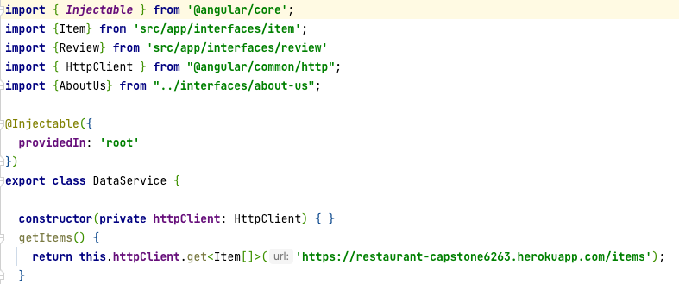
Backend (Mobile DataService)
restaurant_db built in MySQL (Items table example)

Slide 14
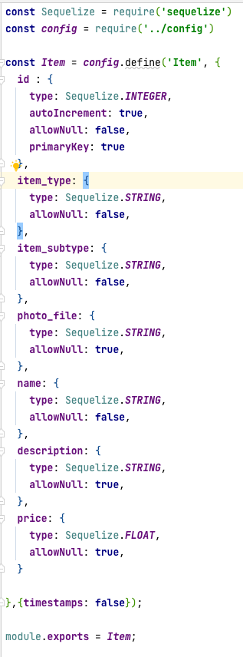
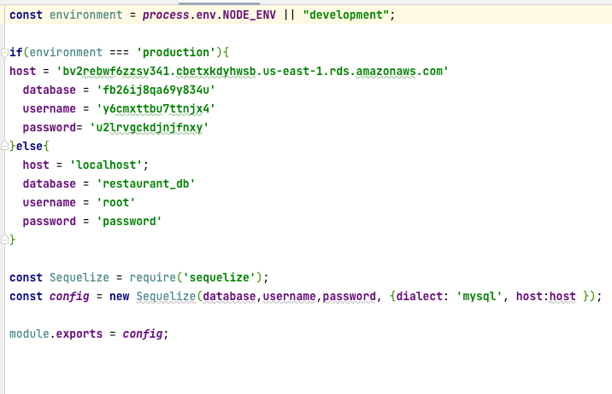
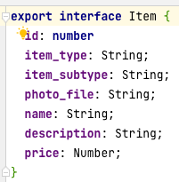
Backend Config.js/Model/Interface
restaurant_db built in MySQL (Items table example)

Slide 15
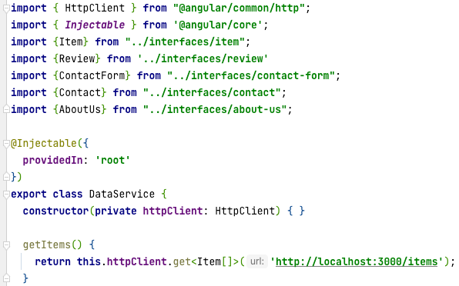
Backend (Web DataService)
restaurant_db built in MySQL (Items table example)

Slide 16
Backend (Web DataService)
restaurant_db built in MySQL (Items table example)

Slide 17
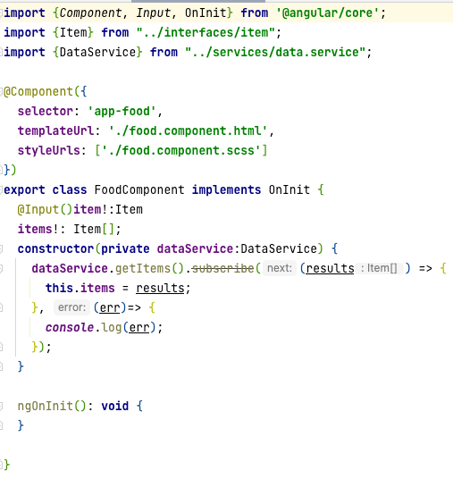
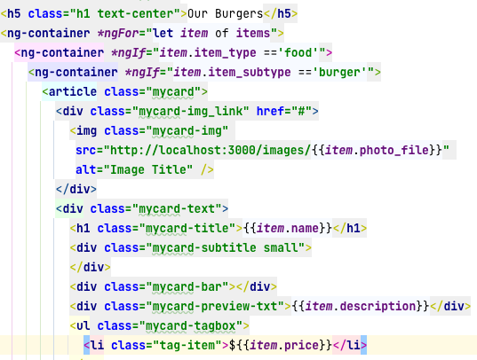
Food component TS & HTML
restaurant_db built in MySQL (Items table example)

Slide 18
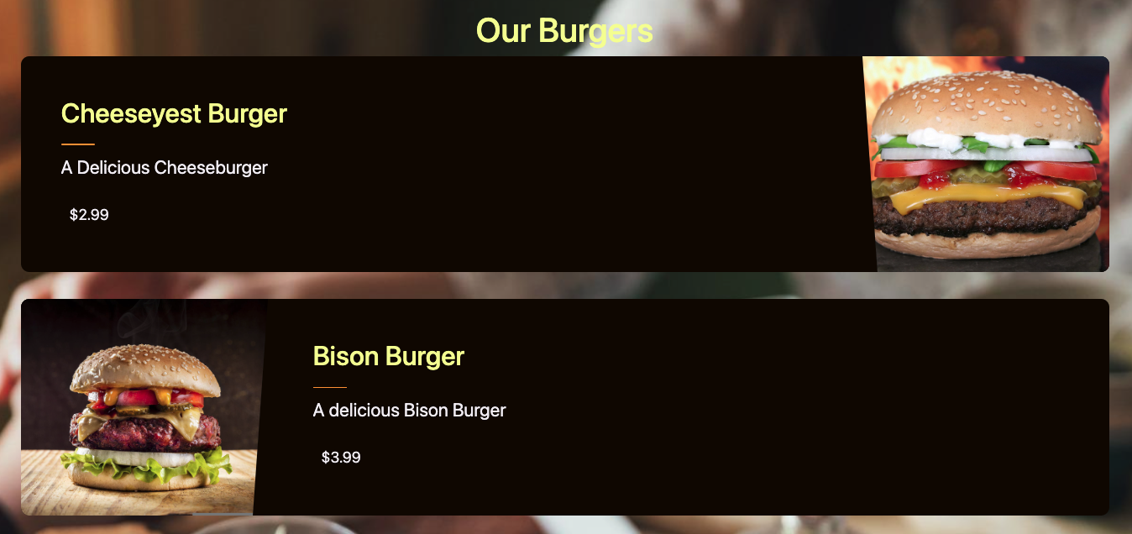
Food component - Result

Slide 19
Web Tech Used - Frontend
Both Web site and app were built using angular
Website front end primarily built using angular components and bootstrap with some sass alterations
Website
Food/Item/Offer Lists and Homepage Launch points are contained in bootstrap cards
Review and contact us pages created using bootstrap lists
Review and contact forms created using bootstrap forms + scss + reactiveForms Module

Slide 20
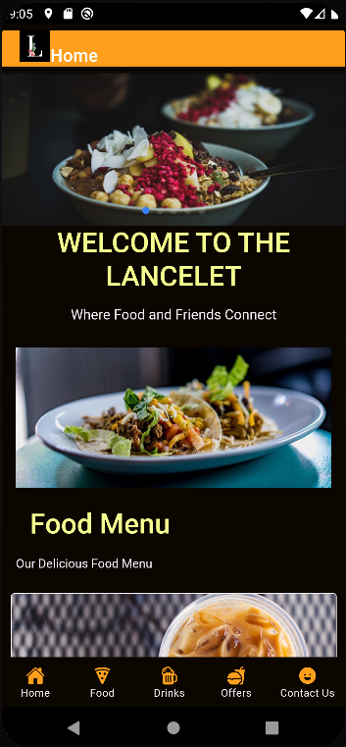
Mobile Tech Used - Frontend
Both Web site and app were built using angular
Website front end primarily built using angular components and bootstrap with some sass alterations
Website
Food/Item/Offer Lists and Homepage Launch points are contained in ionic cards
Review and contact us pages created using ionic lists
Review and contact forms created using ionic forms + scss + reactiveForms Module

Slide 21
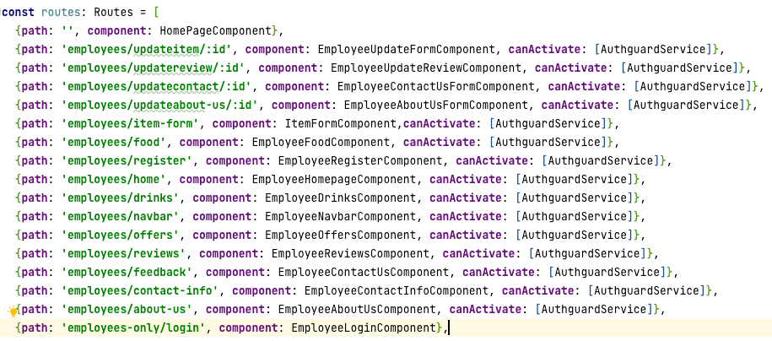
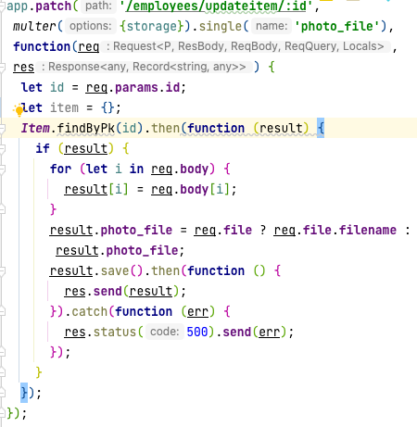
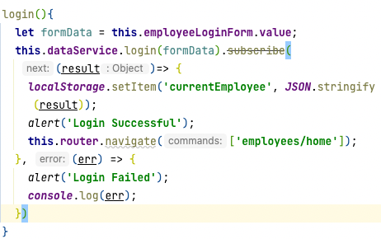
Employee site

Slide 22
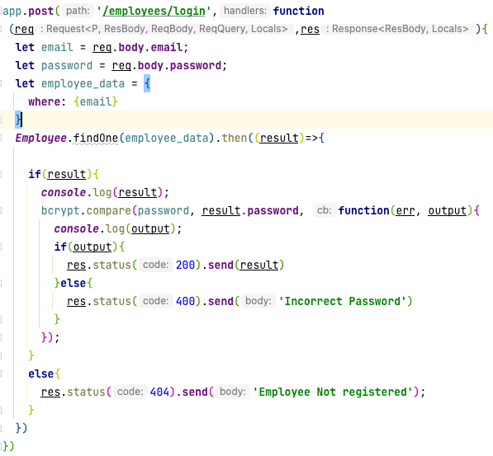
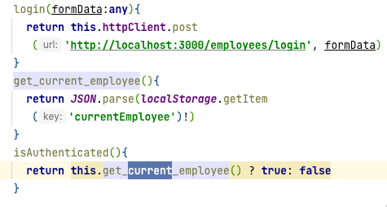
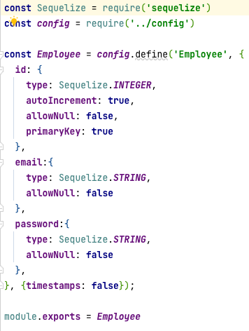
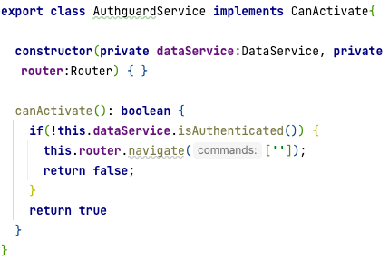
Employee site (Login)
June 21 2022

